Slide 1

ENGINEERING CHEMISTRY
Asha A
Department of Science and Humanities

Slide 2

ENGINEERING CHEMISTRY
Module 5- Energy storage devices – Fuel cells
Class content:
Fuel cells
Principle and working
Advantages
Disadvantages
Applications

Slide 3
ENGINEERING CHEMISTRY
Module 5- Energy Storage devices- Fuel cells
Fuel cells
Chemical energy → Thermal energy → Mechanical energy → Electrical energy
Fuel cell
Galvanic cell which converts chemical energy of a fuel oxidant system directly into electrical energy by means of redox reactions
Do not store energy but convert chemical energy in the fuel to electrical energy
Fuel and oxidising agents have to be continuously supplied at the respective electrodes
Generate power as long as the electroactive material is supplied

Slide 4
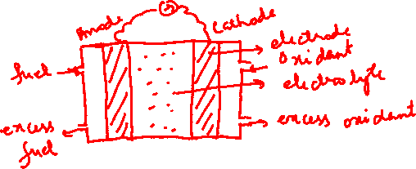
ENGINEERING CHEMISTRY
Module 5- Energy Storage devices- Fuel cells
Construction:
Two electrodes
Catalyst
Electrolyte
Electroactive material supplied at the electrodes
Schematic diagram of a fuel cell
Fuel Electrode Electrolyte Electrode Oxidant

Slide 5
ENGINEERING CHEMISTRY
Module 5- Energy Storage devices- Fuel cells
Working:
Anode : Fuel → Oxidation product + ne⁻
Cathode : Oxidant + ne⁻ → Reduction products
Fuels : H₂, CO, CH₃OH, C₂H₅OH, HCHO, N₂H₄
Oxidants: O₂ , H₂O_{2,} halogens

Slide 6
ENGINEERING CHEMISTRY
Module 5- Energy Storage devices- Fuel cells
Advantages :
High power efficiency (about 50 - 80% )
Ecofriendly - products formed are not toxic
Silent operation
Disadvantages :
Cost of the power is high as a result of the use of
expensive electrodes and catalysts
Power out put is moderate
Fuels in the form of gases and oxygen need to be stored in
tanks under high pressure-special equipment is required

Slide 7
ENGINEERING CHEMISTRY
Module 5- Energy Storage devices- Fuel cells
Applications:
Space exploration; as auxiliary power generators in space
vehicles
Vehicle traction for cars, buses and commercial vehicles
Large scale power generation

Slide 8

ENGINEERING CHEMISTRY
Module 5- Energy Storage devices- Fuel cells
Efficiency of a fuel cell:
Thermodynamic efficiency is given by the ratio of work output to heat input
Work output is Gibb's free energy ; heat input is enthalpy change of the cell reaction
Gibb's free energy, - Measure of the electrical work done
Enthalpy change, - Measure of the heat released during the reaction
Efficiency % =
η% = $\frac{ΔG}{ΔH} ×100=\frac{−nFE}{ΔH}$ × 100

Slide 9
ENGINEERING CHEMISTRY
Module 5- Energy Storage devices- Fuel cells
Alkaline fuel cells
Aqueous solution of KOH is used as electrolyte
Low temperature fuel cell (operates at 100ºC)
Oxygen reduction is more rapid in alkaline electrolytes
than in acid electrolytes
Use of non noble metal electro-catalyst is feasible
Carbon containing fuels cannot be used as CO₂ is
formed as product which reacts with the electrolyte, KOH, to form K₂CO₃ which reduces efficiency of the cell
CO₂ + KOH → K₂CO₃ + H₂O

Slide 10
ENGINEERING CHEMISTRY
Module 5- Energy Storage devices- Fuel cells
Construction :
Anode : Porous carbon impregnated with Pt catalyst
Cathode : Porous carbon impregnated with Ag catalyst
Fuel : Hydrogen gas
Oxidant : Oxygen gas
Electrolyte : 30-45 % KOH(warm)

Slide 11
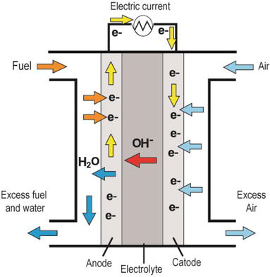
ENGINEERING CHEMISTRY
Module 5- Energy Storage devices- Fuel cells
Cell representation:
H₂|Pt|KOH|Ag|O₂
Source:https://www.intechopen.com/books/new-trends-in-ion-exchange-studies/hydroxide-transport-in-anion-exchange-membranes-for-alkaline-fuel-cells

Slide 12
ENGINEERING CHEMISTRY
Module 5- Energy Storage devices- Fuel cells
Working:
H₂ gas diffuses through anode, gets adsorbed on the electrode surface ,reacts with OH- to form water
At cathode O₂ diffuses through electrode, is adsorbed and reduced to OH-
Product is water which dilutes the KOH
Cell operates at 100ºC, so that water from KOH escapes as steam
The water was used by astronauts for drinking on Apollo spacecraft
Emf = 1.23 V

Slide 13
ENGINEERING CHEMISTRY
Module 5- Energy Storage devices- Fuel cells
Advantages:
Operates at low temperature
Alkali is used as electrolyte hence non noble metal catalyst can
be used so less expensive
Disadvantages:
Reactants must be free from C, because on oxidation CO₂ is formed .The alkali reacts with CO₂ to form carbonates which reduce efficiency of the cells; pure fuel and oxidant which are free of carbon compounds must be used
Liquid electrolytes pose handling problems

Slide 14
THANK YOU
Asha A
Department of Science and Humanities

